Slide 1
Accident Risk Prediction System
Team 11
Aaradhya Sharma - 001040799
Akshay Khandelwal - 001563326

Slide 2
Index
Introduction - Slide 3
Description of Dataset - Slide 4
Analysis - Slide 5
Target Variable - Slide 13
Classification - Slide 15
Data Preprocessing - Slide 16
Methods - Slide 20
Result - Slide 25
References - Slide 26

Slide 3
Introduction
The system aims to predict the occurrence of a probable accident based on the data of past occurred Accidents in the United States of America from year 2016 to 2020.
This system has ‘Severity’ as the target variable and its predictions are based on a variety of intrinsic and contextual attributes such as location, time, natural language description, weather, period-of-day, and points-of-interest.

Slide 4
Description of the Dataset
The Dataset consists information of accident happened in 49 states of the United States of America From February 2016 to June 2020.
Number of Records: 3.5 million
Size: 1.24 GB
Number of Attributes: 49
17 attributes are String,
13 attributes are Boolean,
12 attributes are Decimal,
And 7 are others.
Link: https://www.kaggle.com/sobhanmoosavi/us-accidents

Slide 5
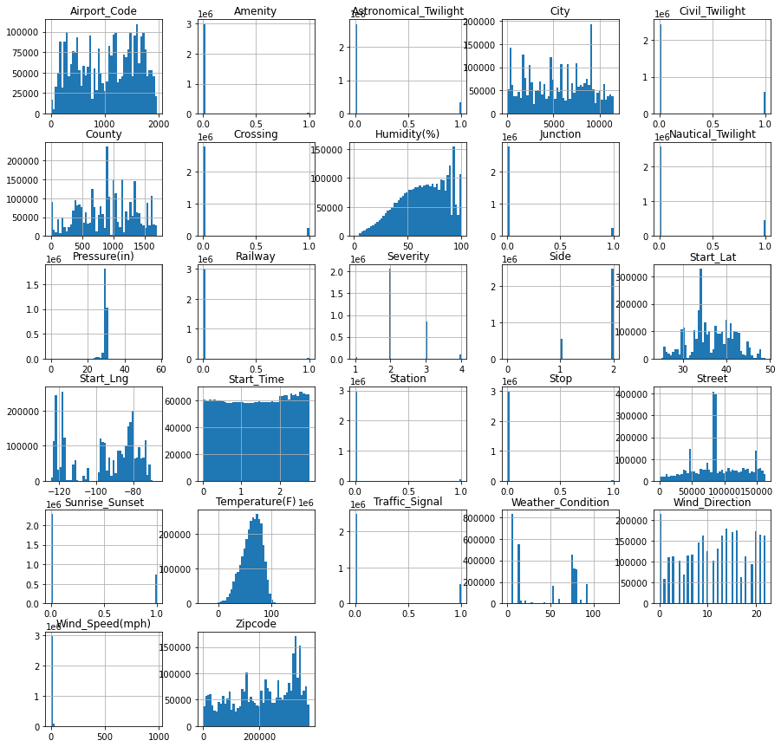
Analysis
ALL EDA PLOT/GRAPHS

Slide 6
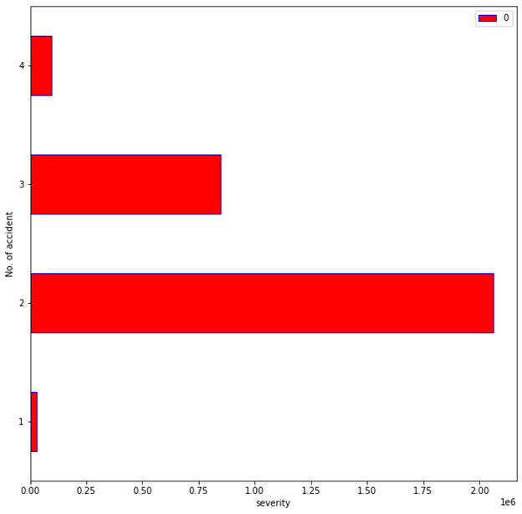
Severity by level

Slide 7
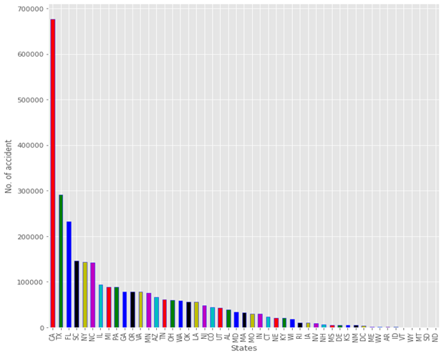
Accident by State

Slide 8
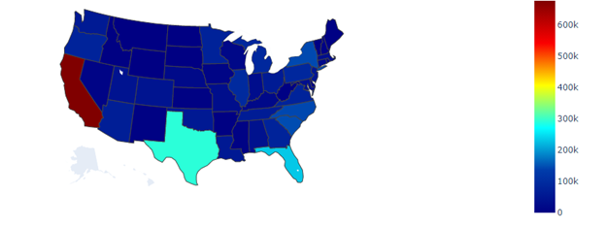
Pictorial Representation of Accidents

Slide 9
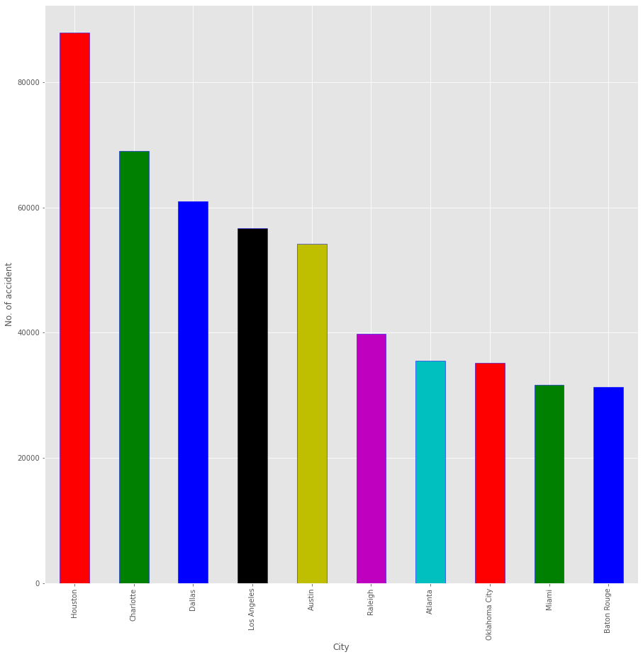
City with most Accident

Slide 10
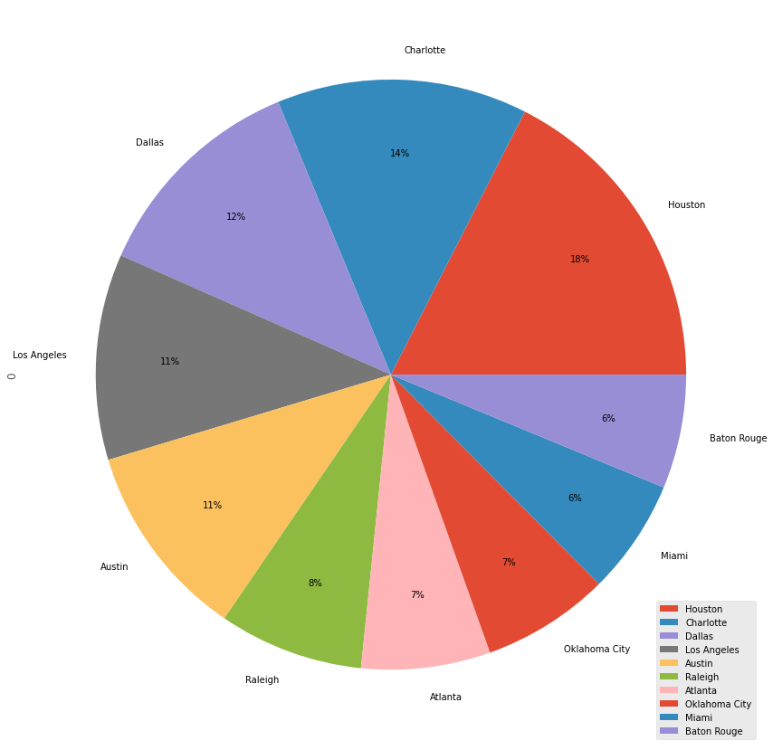
City Accident Pie Chart

Slide 11
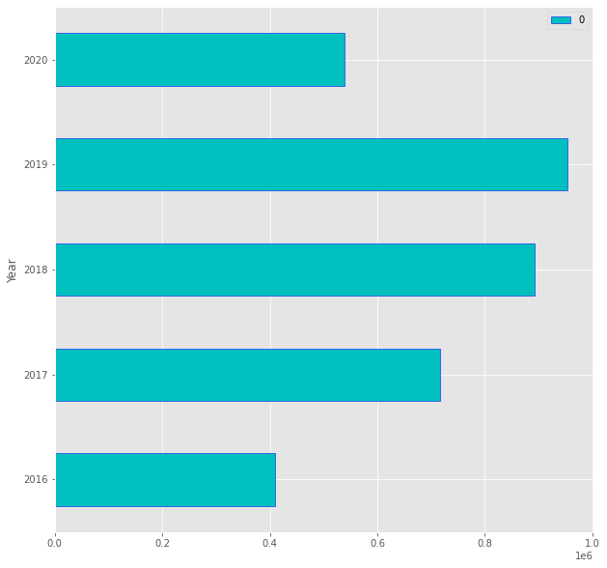
Accident Over The Year

Slide 12
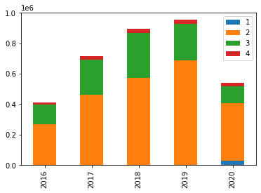
Accident And Severity Combine Graph

Slide 13
Target Variable
The Dependent Target Variable is Severity which contains numerical digits from 0 to 4
Severity Class 0 - no accident, or no injury
Severity Class 1 - accident less severe
Severity Class 2 - a severe accident
Severity Class 3 - a severe accident with loss of live
Severity Class 4 - accident with loss of lives and system failure

Slide 14
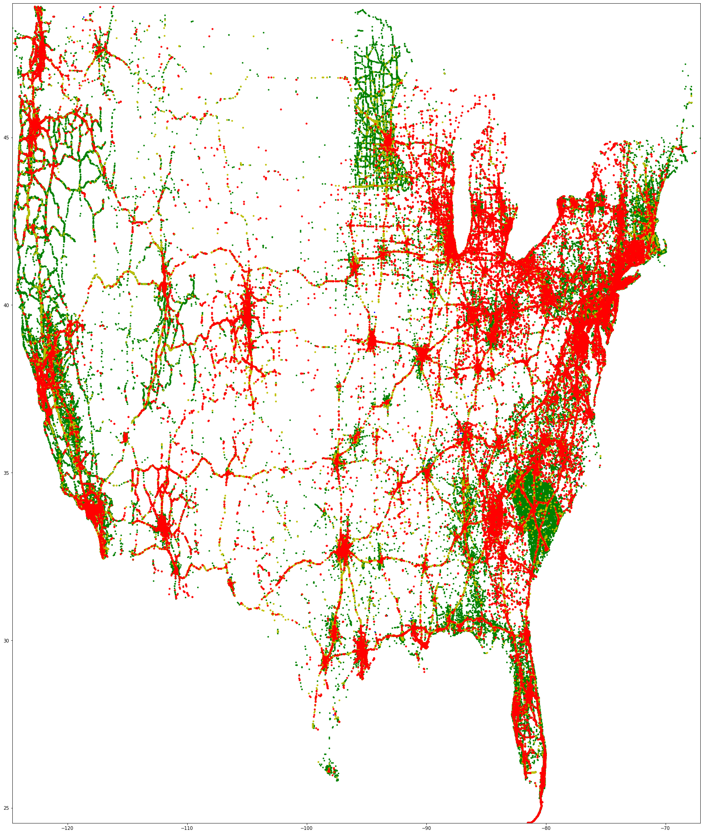
Severity

Slide 15
Classification
Logistic Regression Classification
Support Vector Machine Classification
Naïve Bayes Classification
K-Nearest Neighbor Classification
Decision Tree Classification
Random Forest Classification

Slide 16
Data Preprocessing
Dropping useless Features
ID, TMC, Source, Number, End_Lat, End_Lng, Description, Distance(mi) End_Time, Timezone, Weather_Timestamp

Slide 17

Dropping Categorical Features
Country, Turning_Loop
Dropping Features with Maximum Missing Data
Wind_Chill(F) - 1868249, Precipitation(in) - 2025874

Slide 18
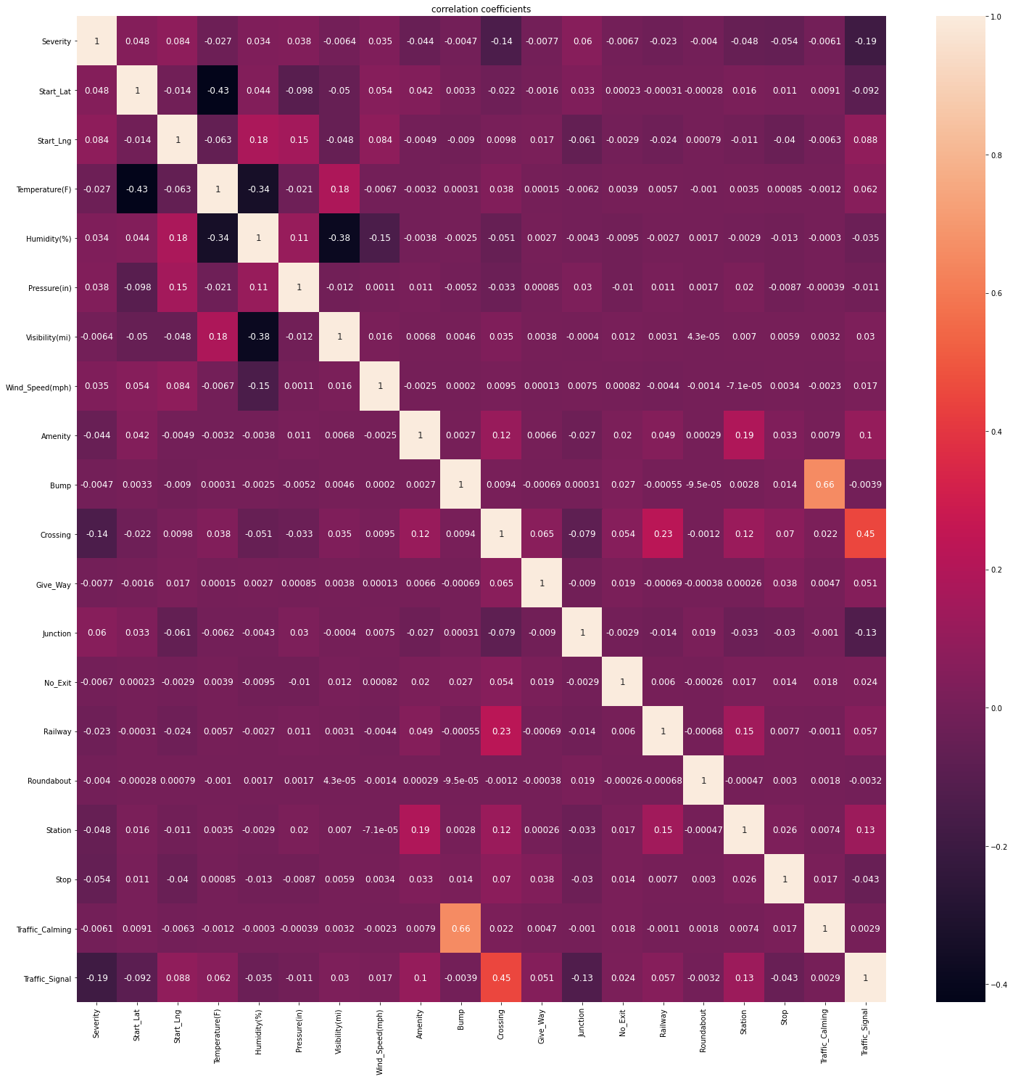
Dropping Features having least Correlation with the Target
Visibility(mi)
Bump
Give_Way
No_Exit
Roundabout
Traffic_Calming

Slide 19

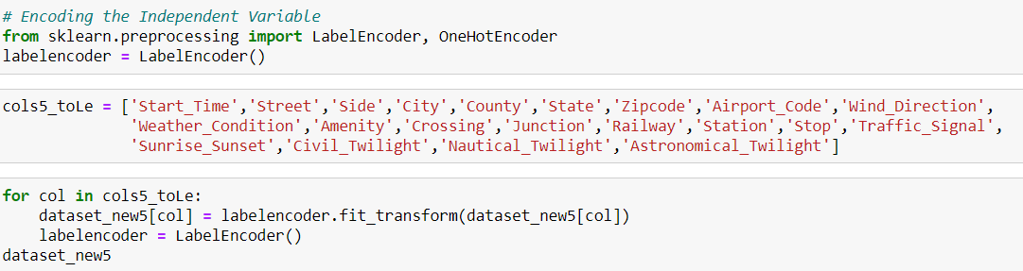
Dropping records with Null value
Encoding the Independent Variable

Slide 20
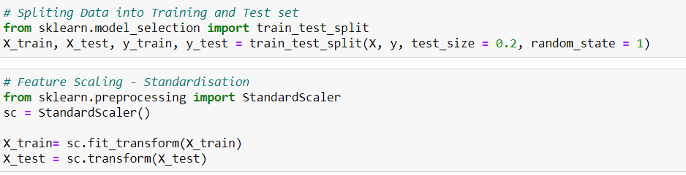
Methods
Split data in Training and Test sets in a 80-20 ratio
Feature Scaling- Standardisation

Slide 21
On All States Data
Accuracy Score
Linear Regression Classifier: 68%
K-NN Classifier: 69%
Naive Bayes Classifier: 50%
SVM Classifier: 68%
Decision Tree Classifier: 80%
Random Forest Classifier: 83%
Confusion Matrix :
[[ 3518 1853 381 21]
[ 1071 376811 33216 1514]
[ 258 47435 120660 1110]
[ 86 6777 4109 7884]]

Slide 22
State of California
Accuracy Score
Linear Regression Classifier: 73%
K-NN Classifier: 78%
Naive Bayes Classifier: 44%
SVM Classifier: 72%
Decision Tree Classifier: 83%
Random Forest Classifier: 85%
Confusion Matrix :
[[ 735 410 15 3]
[ 216 91220 6625 48]
[ 43 11070 23473 44]
[ 6 789 201 305]]

Slide 23
State of South Carolina
Accuracy Score
Linear Regression Classifier: 79 %
K-NN Classifier: 83%
Naive Bayes Classifier: 80 %
SVM Classifier: 78 %
Decision Tree Classifier: 86 %
Random Forest Classifier: 88%
Confusion Matrix :
[[ 735 410 15 3]
[ 216 91220 6625 48]
[ 43 11070 23473 44]
[ 6 789 201 305]]

Slide 24
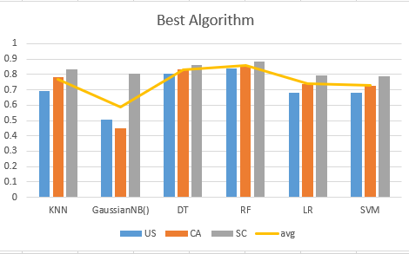

Slide 25
Result
We found the Random Forest Algorithm as the Best for Predicting the value of the Target Variable Severity for this analysis.

Slide 26
References
https://www.kaggle.com/sobhanmoosavi/us-accidents
https://stackoverflow.com/
https://cran.r-project.org/web/packages/dlookr/vignettes/EDA.html
Moosavi, Sobhan, Mohammad Hossein Samavatian, Srinivasan Parthasarathy, and Rajiv Ramnath. “A Countrywide Traffic Accident Dataset.”, arXiv preprint arXiv:1906.05409 (2019).
Advances in Geographic Information Systems, ACM, 2019.
https://scikit-learn.org/stable/
https://matplotlib.org/

Slide 27
Thank You

